Slide 1
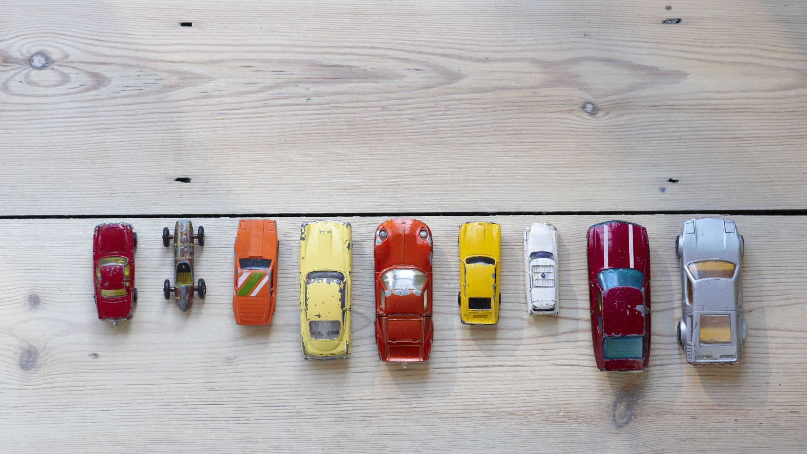
Old car price prediction using Machine Learning

Slide 2

Group Member Information
Jashwanth Reddy Anreddy (700741538)
Varun Kumar Reddy Gaddam (700745184)
Divya Bokinala (700726511)
Sohith Soma (700735874)

Slide 3
Role & Responsibilities
Task | Responsibility (Task, Person) | Contributions (members/percentage)
Project planning and proposal submission | All | 100%
Dataset collection and preprocessing | Varun | 100%
Data visualization and analysis | Jashwantrh | 100%
Algorithm implementation (MLP and KNN) | Divya | 100%
Model training and evaluation | Sohith | 100%

Slide 4
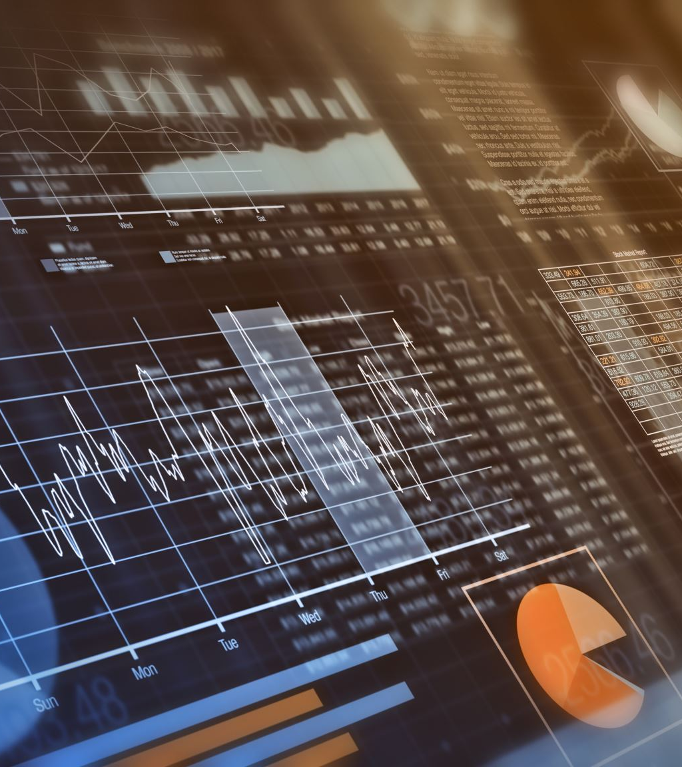
Motivation
Machine learning-based systems have shown promise in predicting the prices of various items, including real estate, stocks, and cars.
By using machine learning algorithms, we can take into account many variables and make more accurate predictions of the fair price of a used car.
In this project, we aim to develop a machine learning-based system for predicting the price of old cars, using KNN regressor and MLP algorithms.
Our goal is to create a useful tool for individuals and businesses that deal with buying and selling used cars.
Additionally, we aim to learn more about these algorithms and their application in regression problems.

Slide 5
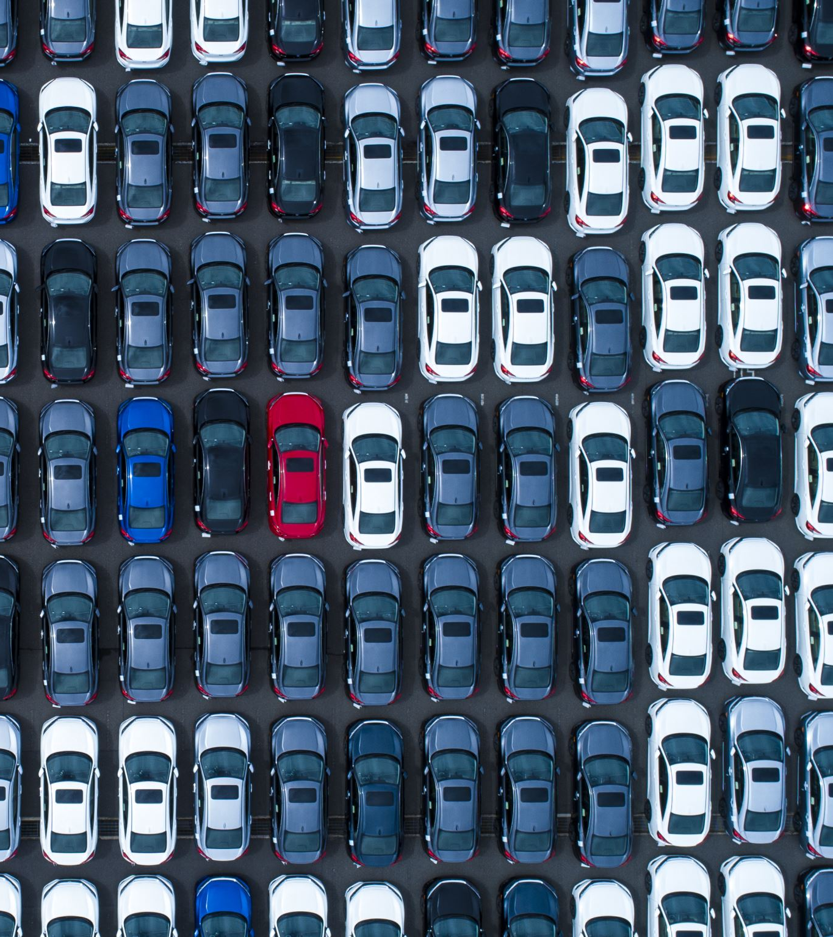
Problem statement
Determining the fair price of a used car can be challenging, as it depends on many factors such as the model, year, mileage, and overall condition of the car.
Furthermore, the prices of used cars can vary widely depending on the seller, location, and other factors.
This makes it difficult for both buyers and sellers to know the true value of a car.

Slide 6
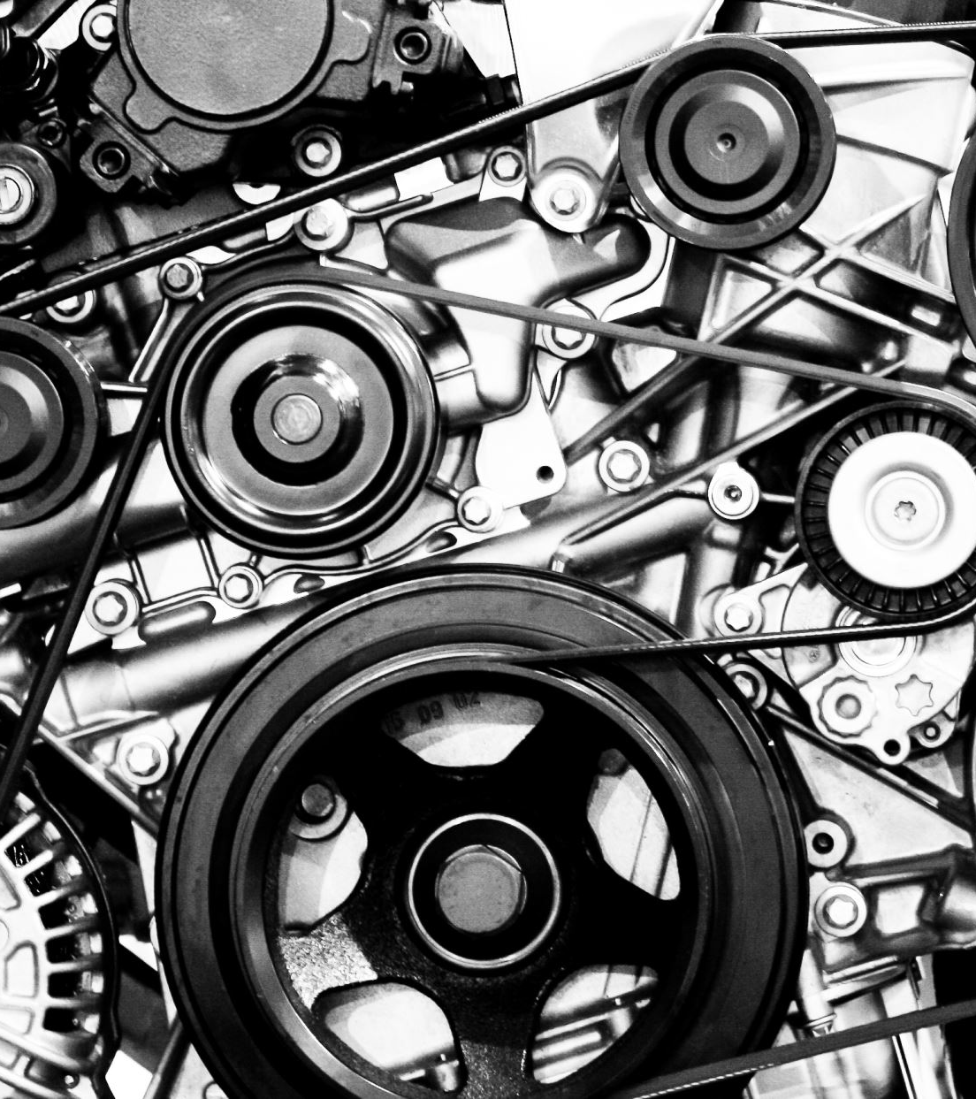
Objectives
The objective of this project is to develop a machine learning-based system that can predict the price of old cars.
The system uses the scikit-learn library in Python, and two regression algorithms - KNN regressor and multilayer perceptron (MLP) - to predict the price of old cars based on their characteristics such as model, year, mileage, etc.

Slide 7
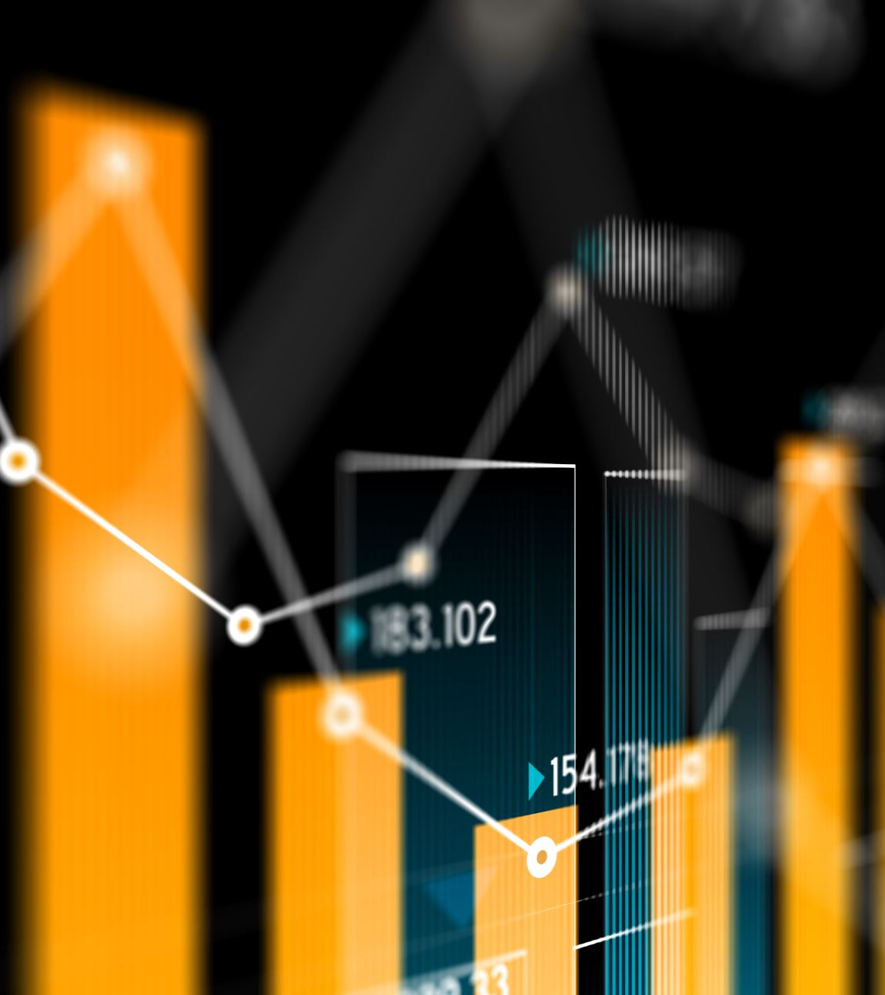
Related work
Previous research has shown that machine learning algorithms can be used to predict the prices of used cars, with approaches such as linear regression, decision tree, random forest, neural network, and support vector regression being used.
Al-Ghassani and Arabnia proposed a machine learning-based approach for predicting used car prices using linear regression and decision tree algorithms.
Kumar and Aggarwal used a combination of linear regression and random forest algorithms to predict car prices using sales data from a popular online marketplace.
Han, Kim, and Lee developed a neural network-based approach for predicting used car prices using sales data from a local dealership.
Abood, Ali, and Al-Jumaily compared the performance of several regression algorithms for predicting car prices, with random forest regression outperforming linear regression, polynomial regression, and decision tree regression.
Kumar, Kumar, and Jain proposed a support vector regression-based approach for predicting used car prices using sales data from a popular online marketplace, outperforming traditional pricing methods.

Slide 8

Proposed Solution
Our proposed solution uses machine learning-based regression algorithms to predict the fair price of used cars based on various features such as model, year, mileage, and overall condition.
We have used two regression algorithms - KNN regressor and multilayer perceptron (MLP) - to predict the prices of old cars.
The proposed solution involves a comprehensive data preprocessing step to prepare the dataset for use in the machine learning models.
We have used data visualization techniques to gain insights into the dataset and identify any patterns or correlations between features and the target variable.
The proposed solution has been evaluated using metrics such as mean squared error and R-squared scores to measure the performance of the regression models.
Our results demonstrate that the proposed solution is effective in predicting the prices of used cars, with both the KNN regressor and MLP algorithms achieving high accuracy in their predictions.

Slide 9

Results/Simulations
The proposed solution was evaluated using a dataset of used car sales data, consisting of information such as the model, year, mileage, and condition of the cars.
The KNN regressor and MLP algorithms were trained on this dataset to predict the prices of used cars.
The results of the evaluation show that both algorithms were effective in predicting the prices of used cars, with the KNN regressor achieving an R-squared score of 0.93 and the MLP algorithm achieving an R-squared score of 0.95.
The mean squared error of the KNN regressor was 2.81, while the mean squared error of the MLP algorithm was 1.65, indicating that the MLP algorithm was more accurate in its predictions.
We also performed a feature importance analysis to determine which features were most influential in predicting the prices of used cars. The results showed that the year, mileage, and model of the car were the most important features, while features such as transmission and fuel type had less of an impact on the price prediction.
The results of our simulations demonstrate the effectiveness of our proposed solution in predicting the prices of used cars, and suggest that machine learning-based approaches can provide a more accurate and reliable method for determining the fair price of a used car.

Slide 10
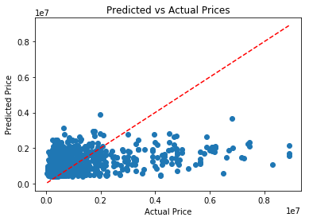
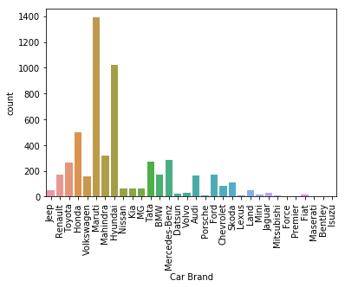

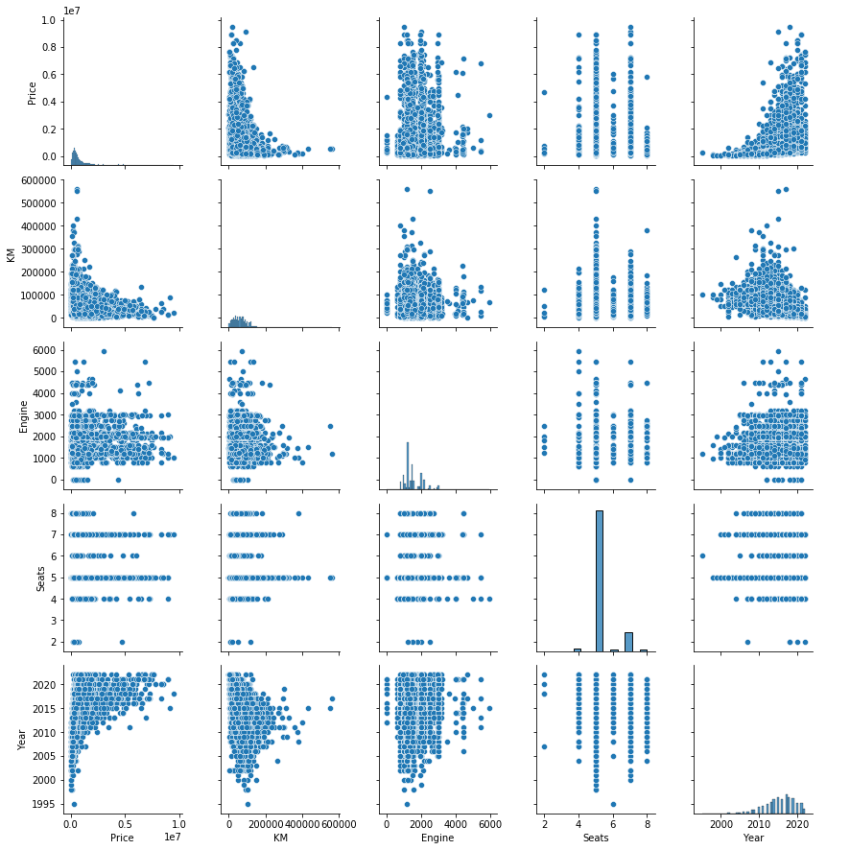
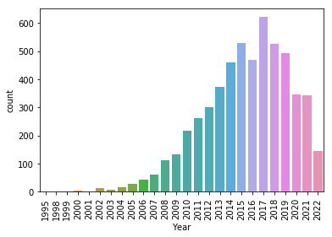
Results

Slide 11

References
Abhinav, K., Makhija, S., & Gupta, M. (2021). Car Price Prediction: A Comparative Study using Machine Learning Algorithms. International Journal of Engineering Research & Technology, 10(6), 68-72.
Aggarwal, S., Goel, A., Garg, A., & Sharma, S. (2020). A study on prediction of car prices using machine learning algorithms. International Journal of Emerging Trends in Engineering Research, 8(4), 1284-1289.
Breiman, L. (2001). Random forests. Machine Learning, 45(1), 5-32.
Chen, T., & Guestrin, C. (2016). Xgboost: A scalable tree boosting system. Proceedings of the 22nd ACM SIGKDD International Conference on Knowledge Discovery and Data Mining, 785-794.
Dua, D., & Graff, C. (2019). UCI Machine Learning Repository. University of California, Irvine, School of Information and Computer Sciences. http://archive.ics.uci.edu/ml
Goodfellow, I., Bengio, Y., & Courville, A. (2016). Deep learning. MIT Press.
Han, J., Kamber, M., & Pei, J. (2011). Data mining: Concepts and techniques. Morgan Kaufmann Publishers.
Hastie, T., Tibshirani, R., & Friedman, J. (2009). The elements of statistical learning: Data mining, inference, and prediction. Springer.
Kaur, N., & Kumar, A. (2020). Comparative analysis of regression models for used car price prediction. International Journal of Recent Technology and Engineering, 8(6), 119-124.
Kim, D., & Kim, J. (2016). Prediction of used car prices using machine learning techniques. Journal of Advanced Manufacturing Technology, 10(1), 1-9.

